Slide 1
CHAPTER 5 Predictive Control with constraints 15 Comparison of MCAS for dual-mode approaches with tracking
Anthony Rossiter

Slide 2
Background
This chapter has shown how constraint inequalities can be defined for OMPC/SOMPC algorithms.
It has also presented some efficient MATLAB code for forming the minimal inequalities required to ensure constraint satisfaction over an infinite horizon.
This video takes the examples from videos 10-13 and constructs the MCAS using the proposed algorithm.

Slide 3
Summary
We quickly restate the format of OMPC/SOMPC used for the admissible set algorithm.
Dynamics in autonomous model format:
Constraints expressed each sample.
Except for modes that appear only in
G₂ Z<= f₂.

Slide 4
Autonomous model formulation
Autonomous model for prediction which includes the target/disturbance estimate as an extra state:

Slide 5
Sample constraints
Because we assume the value r-d is constant, these rows will not be carried forward in any admissible set iteration.

Slide 6
Requirements on targets
The steady-state must lie in the interior of the set.
Users should check their targets against these inequalities before deploying.
It is possible that even stricter limits are needed, that is, these are necessary but not sufficient.

Slide 7
MATLAB code
In OMPC folder.
MAIN CODE is ompc_simulate_efficient.m
The examples discussed hereafter however focus mainly on a comparison of the different MCAS methods discussed so far.
If the limits on r-d are generous, one may need a very large number of inequalities to capture the MCAS.

Slide 8
Methods
findmas_tracking.m
Very simple or easy to follow algorithm but no removal of redundant constraints. Extremely inefficient.
sompc_constraints.m
Simple concept, constraints easy to define, flexible to changes in target. However, hugely inefficient as carries large numbers of redundant inequalities and requires ‘arbitrary’ horizon choice.
construct_mas_tracking.m
Efficient and removes redundant constraints. However, requires explicit and feasible limits on the signal r-d.

Slide 9
video5_15_example1.m
findmas_tracking gave 26 inequalities.
construct_mas_tracking gave 16 inequalities.
sompc_constraints – horizon*6 inequalities (horizon typically 20 or so)

Slide 10
video5_15_example2.m
findmas_tracking gave 1644 inequalities and took 100 seconds to compute!
construct_mas_tracking gave 35 inequalities and took 10 seconds to compute.
sompc_constraints – horizon*10 inequalities (horizon typically 20 or so)
This example has only 3 states and already the need for an efficient algorithm is obvious!

Slide 11
Sample constraints and MCAS
Clearly a substantial reduction in size!

Slide 12
The importance of feasibility
video5_15_example3.m gives a case where the limits on r-d are excessively large and therefore clearly not achievable.
Viewers will note that the admissible set algorithm struggles to converge as, in essence, the steady-state can end up on a boundary of the MCAS.
Specifically, viewers will note that despite the limits be entered originally as:
The projection of the MCAS gives (approx):
We do not want to dwell on feasibility in this chapter, rather simply to highlight the importance of this issue!

Slide 13
Summary
This video has utilised an efficient algorithm for determining the MCAS for OMPC/SOMPC and incorporated into the code.
This MCAS is based on an augmented state which includes the ‘target’ steady-state and thus is flexible to changes in target and disturbance.
This target must be reachable, and also feasible during transients with the given n_{c}; feasibility issues will form a later chapter.
If the limits on r-d are poorly chosen, the code can be very slow to converge.
Ensuring feasibility is beyond the remit of this chapter.

Slide 14



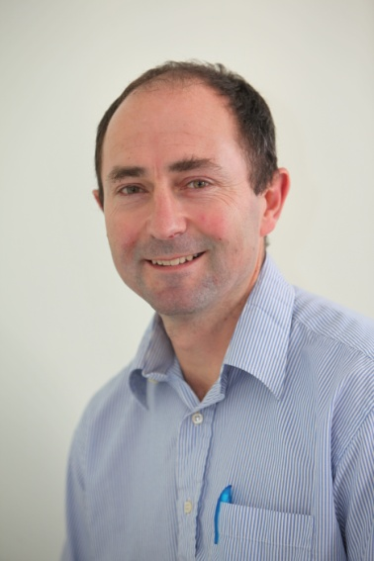
Anthony Rossiter
Department of Automatic Control and Systems Engineering
University of Sheffield
www.shef.ac.uk/acse
© 2014 University of Sheffield
This work is licensed under the Creative Commons Attribution 2.0 UK: England & Wales Licence. To view a copy of this licence, visit http://creativecommons.org/licenses/by/2.0/uk/ or send a letter to: Creative Commons, 171 Second Street, Suite 300, San Francisco, California 94105, USA.
It should be noted that some of the materials contained within this resource are subject to third party rights and any copyright notices must remain with these materials in the event of reuse or repurposing.
If there are third party images within the resource please do not remove or alter any of the copyright notices or website details shown below the image.
(Please list details of the third party rights contained within this work.
If you include your institutions logo on the cover please include reference to the fact that it is a trade mark and all copyright in that image is reserved.)

